Slide 1
Project 2 : Fixed Assets Operations And Reporting In Oracle ERP .
Objective to enable the user to manage the lifecycle of fixed assets , including additions ,depreciation ,transfers and retirement and perform period closing tasks in the fixed assets module.

Slide 2
Meet our Team
Ahmed Alaa-Eldin Mostafa Abdalazeem
Amr Adel Abdelrashed Gaballah
Mohamed Medhat Mohamed Elsayed
Mostafa Mohamed Salah Alaa-Eldin
Mohamed Kamal Ali
Mirna Waheed Gerges

Slide 3
List of Contents
Asset Additions And Basic Management.
Asset Depreciation And Transactions.
Asset Retirement And Period Close.
This is the material point that will be delivered in the presentation.

Slide 4
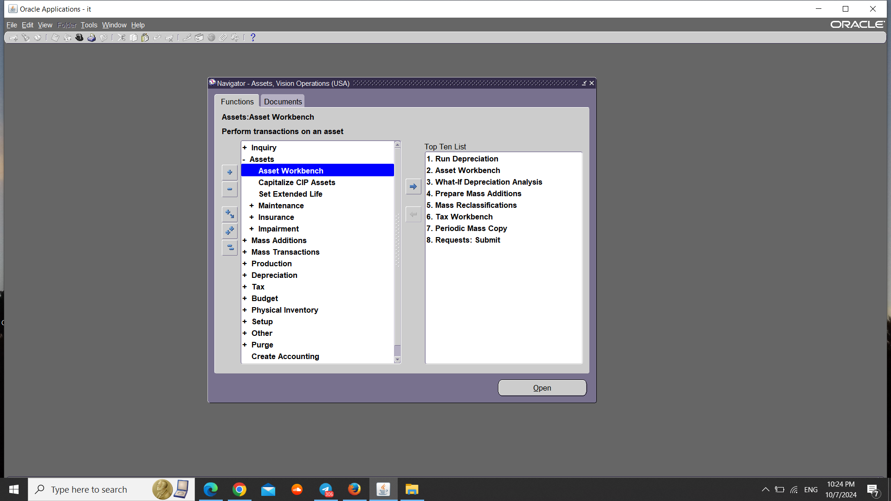
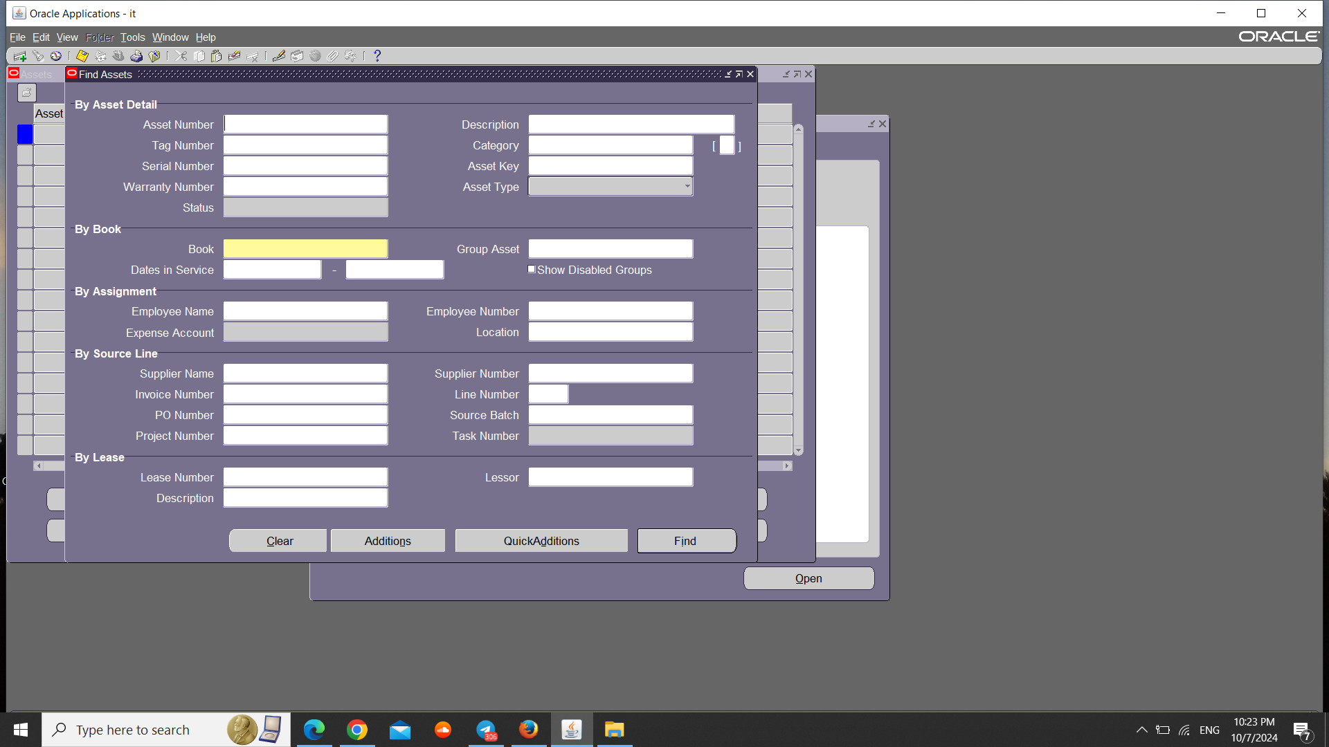
Keys Elements :-
1- Add New Assets. 2- Mass Additions Process.
3- Asset Categories. 4- Asset Inquiry.
1- Add New Assets:- We have two methods for adding a new asset: through additions or quick additions.
Through Standard additions
1- Assets -> Asset workbench .
2- Click on Additions .

Slide 5
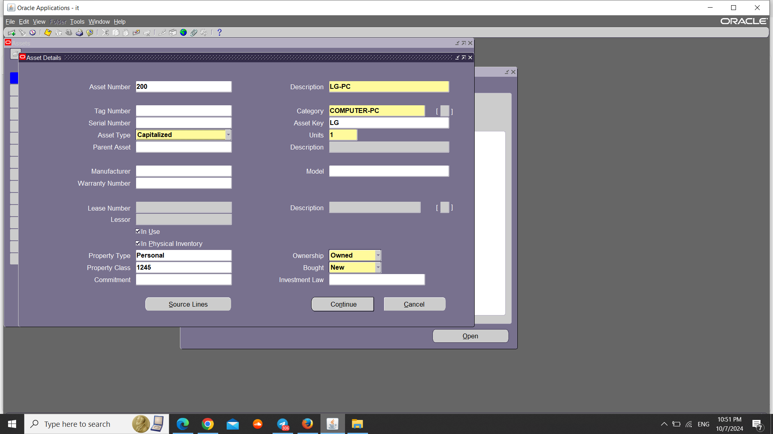
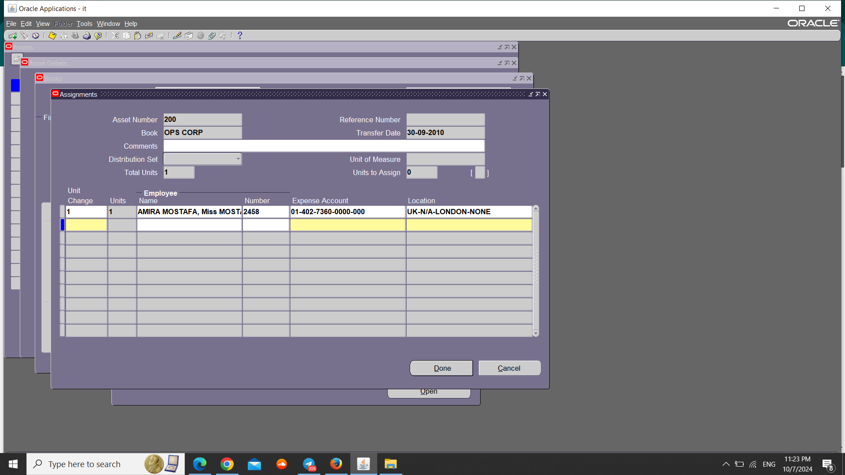
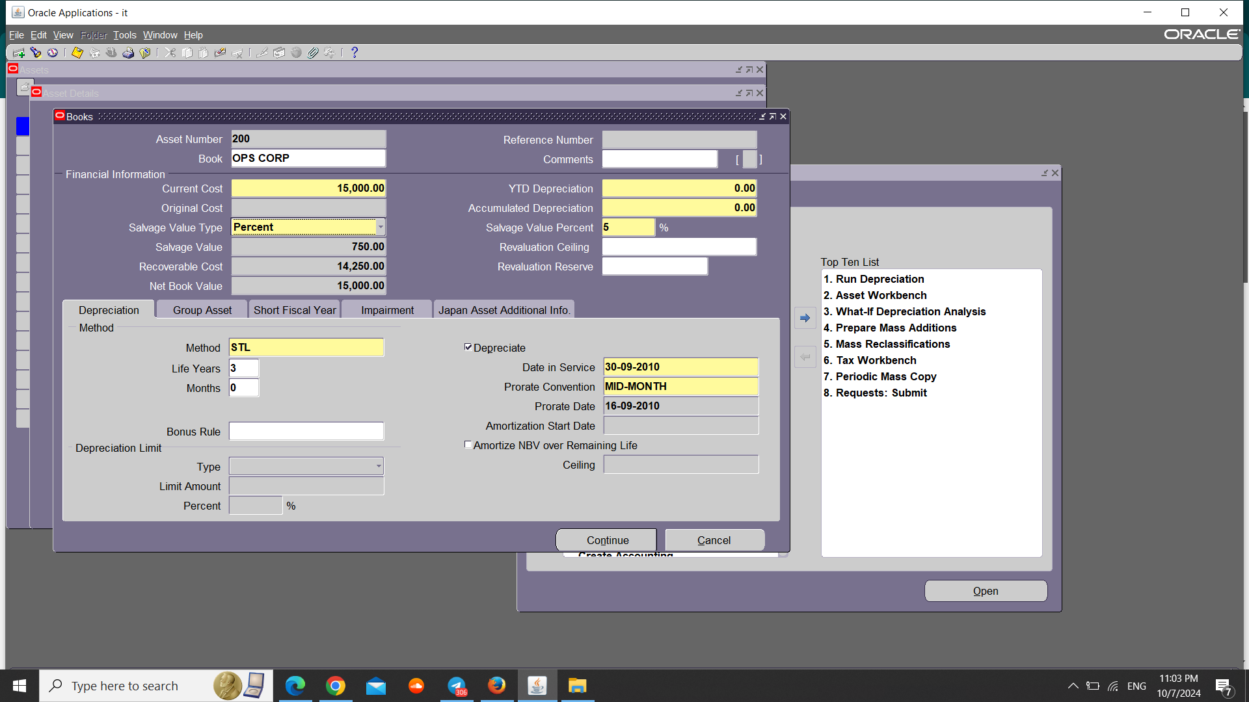
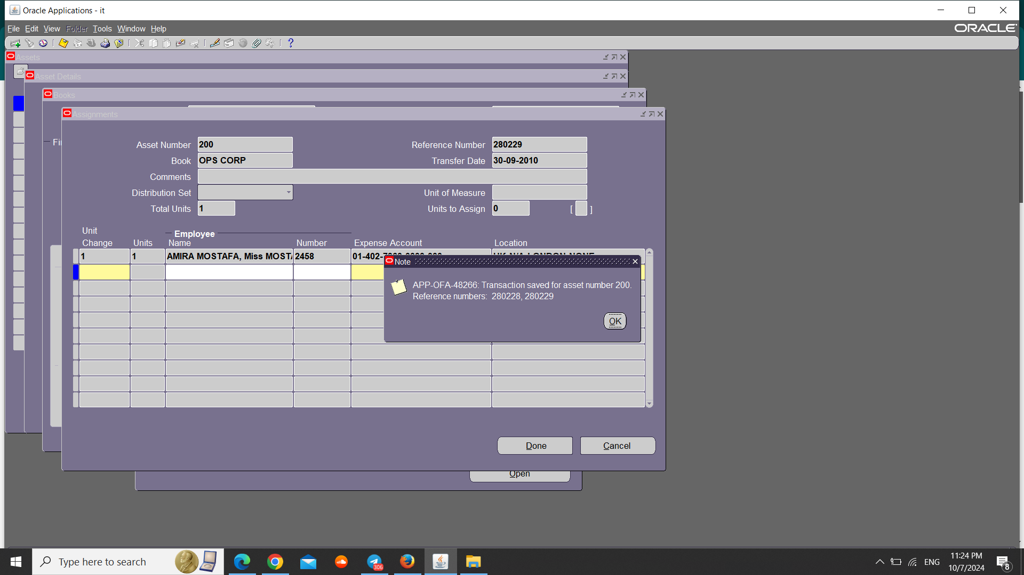
3- Enter the Required data Such as Description, Category , Asset Key and Units Then Click on Continue.
5- Enter the Unit Change, Expense Account and Location. Then Click on Done.
4- Enter the Financial Information. Then Click on Continue.
6- A Note showing the Asset number and Reference number then Click on OK and Close .

Slide 6
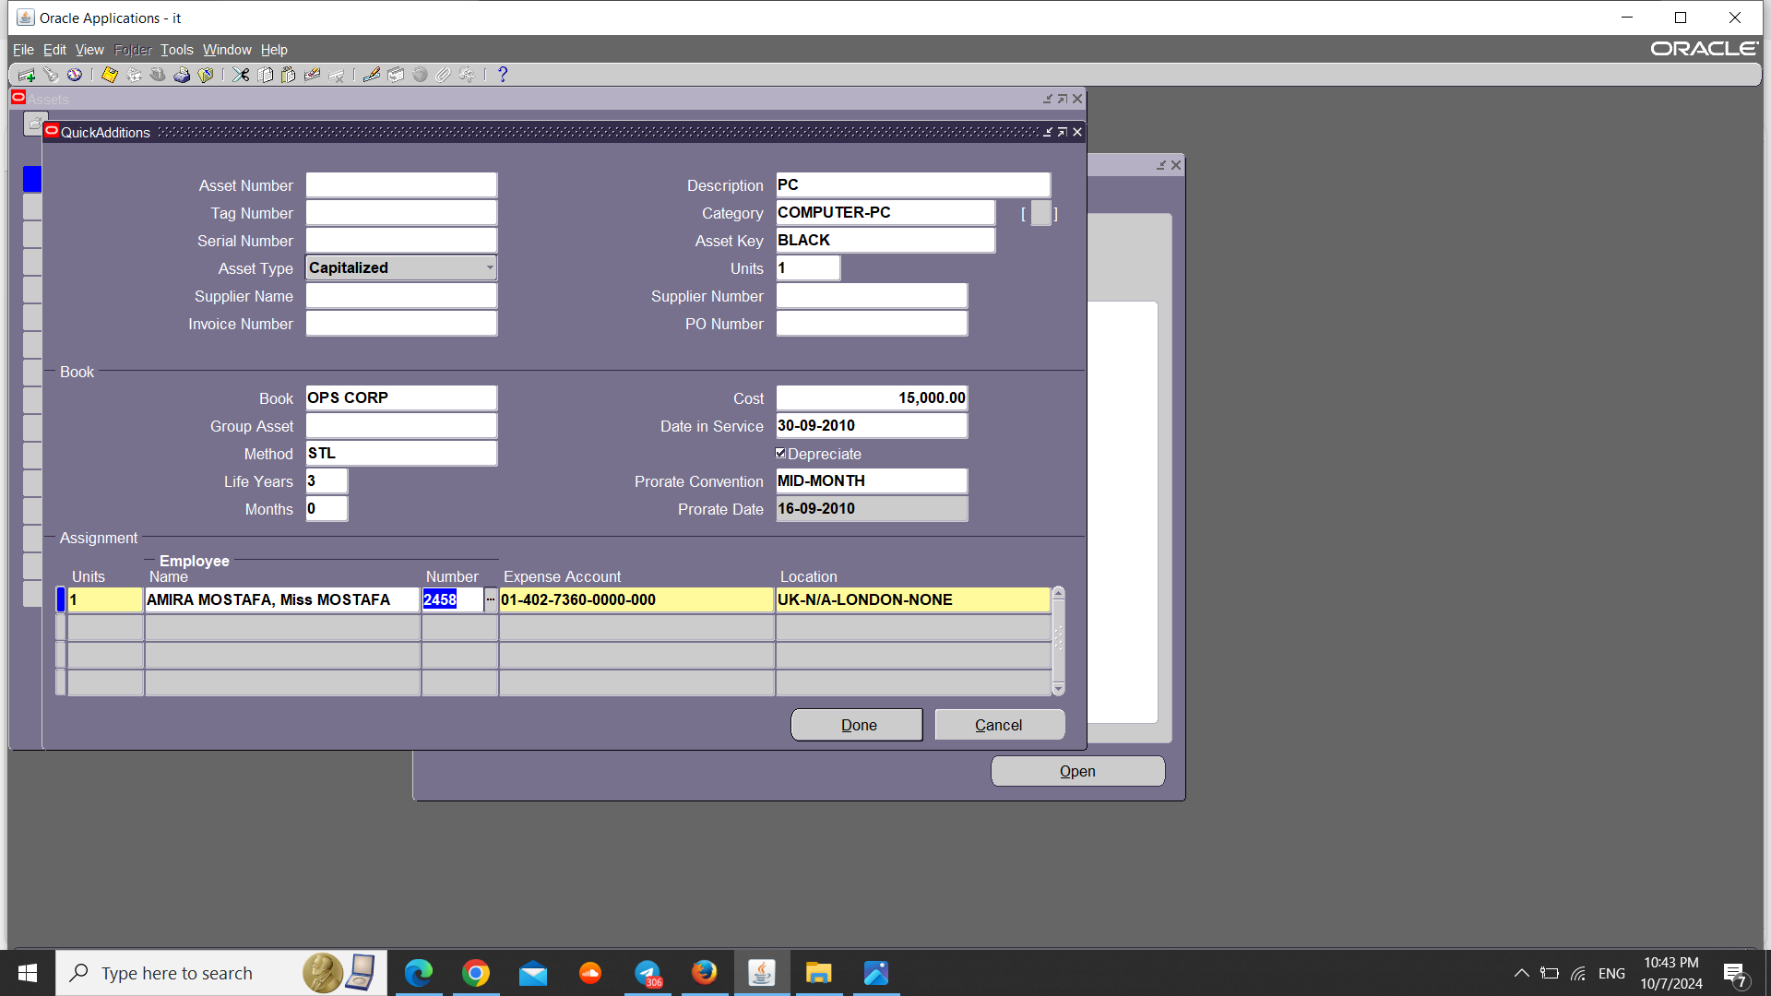
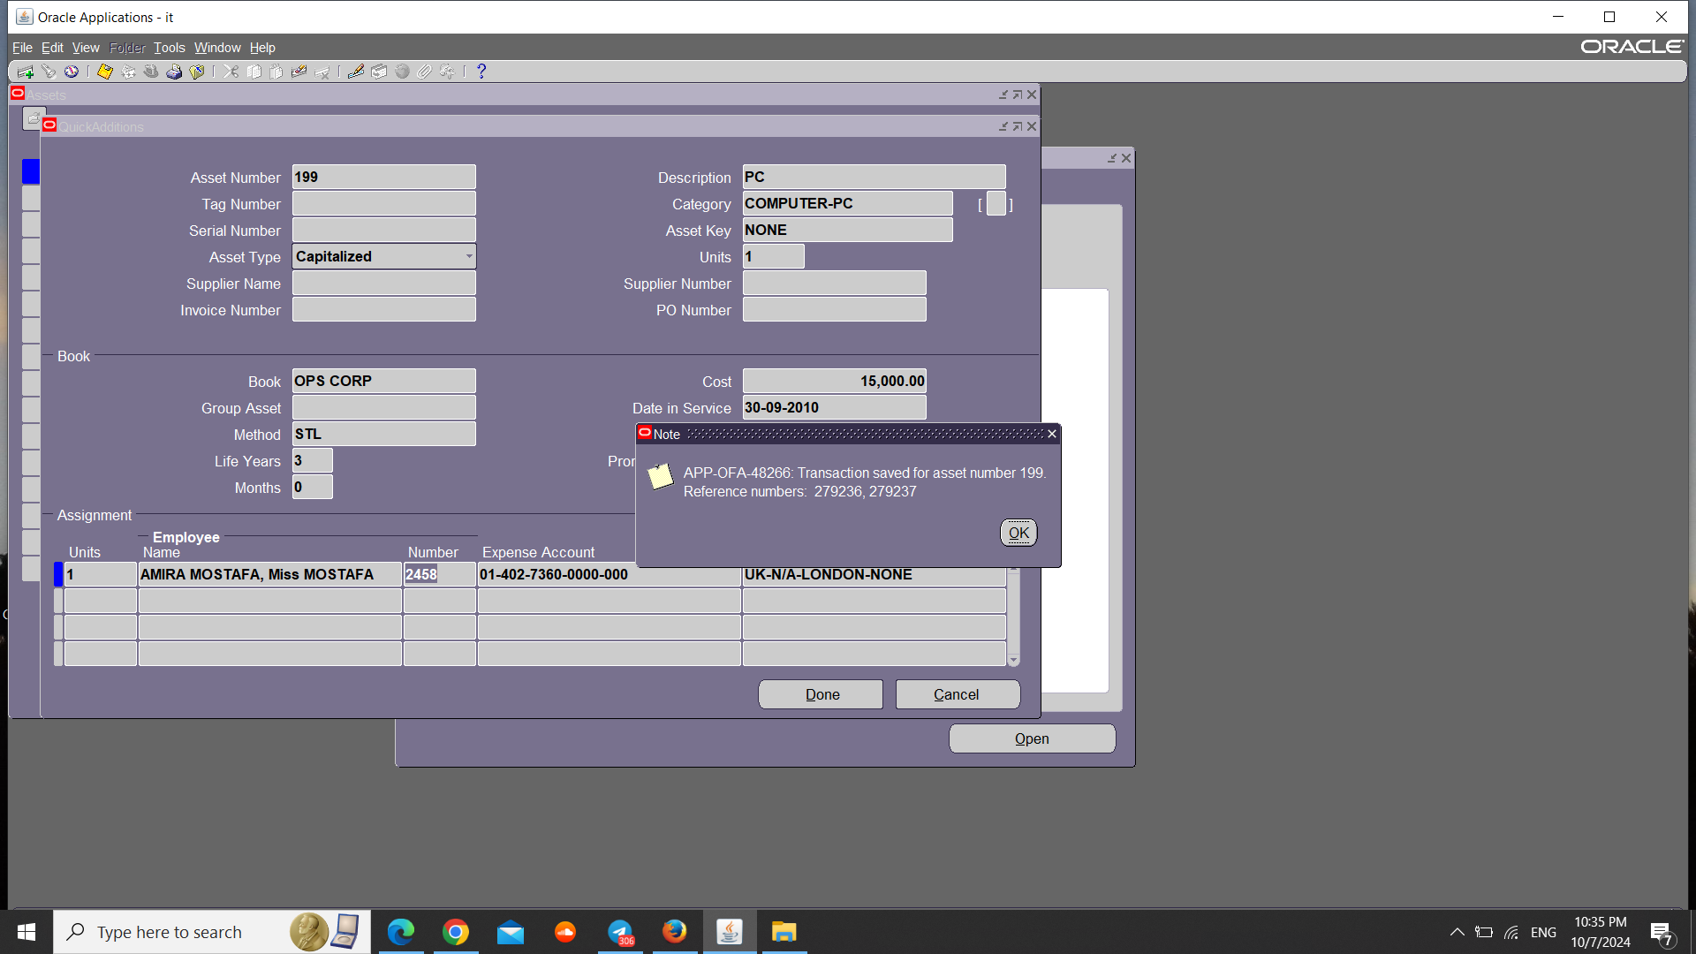
Quick Additions
1- Assets -> Asset Workbench.
3- Enter the Required data then Click on Done.
2- Click on Quick Additions.
4- Click on OK and Close.

Slide 7
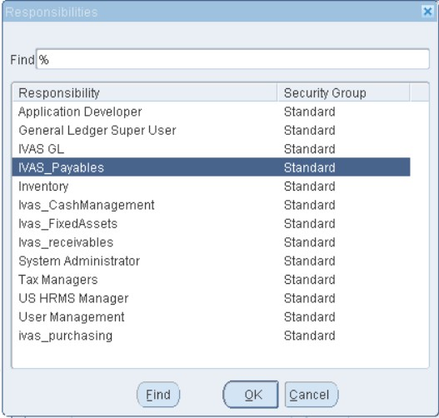
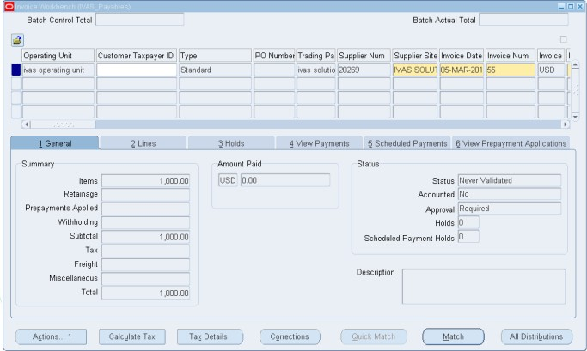
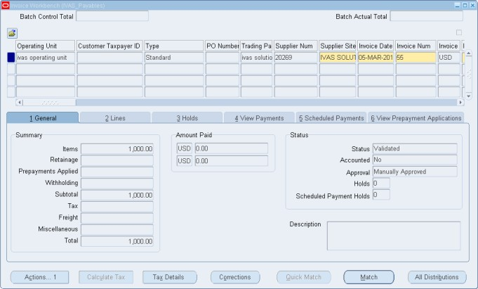
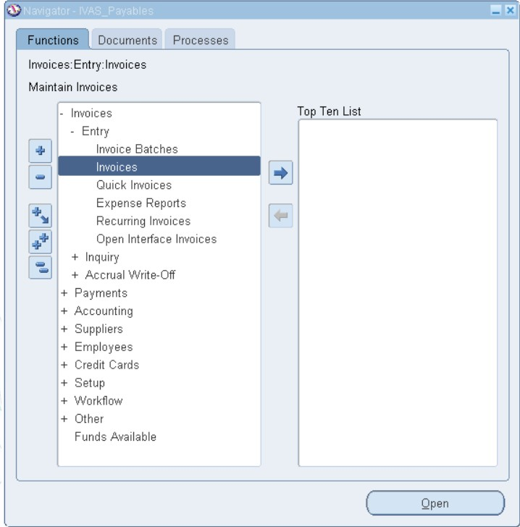
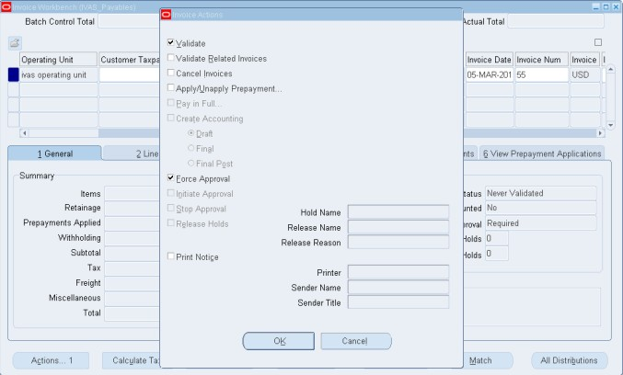
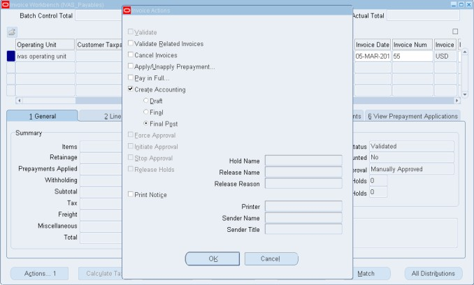
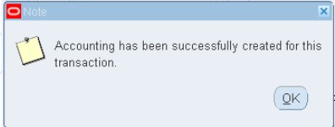
2- Mass additions. :- are a method of entering multiple fixed assets into an accounting system at the same time. This process is often used when a company acquires many assets in one transaction, such as during bulk purchases.
Use The Mass additions Process to add assets From Account Payable Module.
1- Switch Responsibility: - Ivas Payables.
4- Status Changes To Validated.
3- Entry -> A Standard Invoice.
2- Invoices -> Entry -> Invoices.
4- Click on Action1 -> Validate and Force Approval.
5- Click on Actions 1 -> Create Accounting -> ok.
.

Slide 8
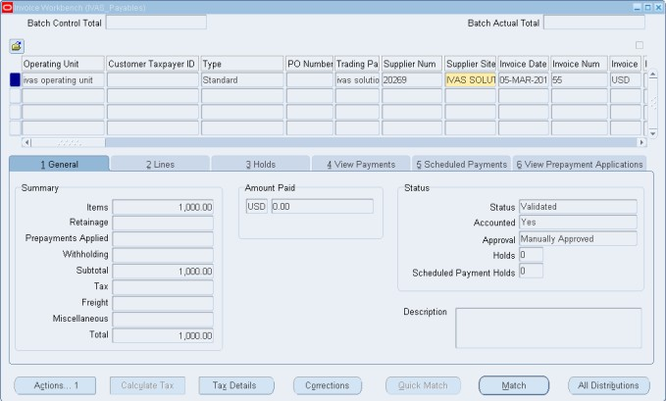
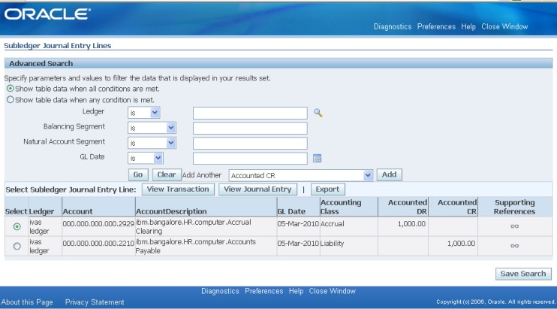
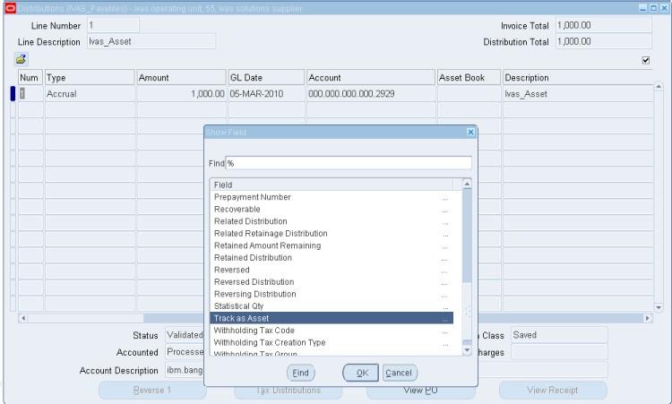
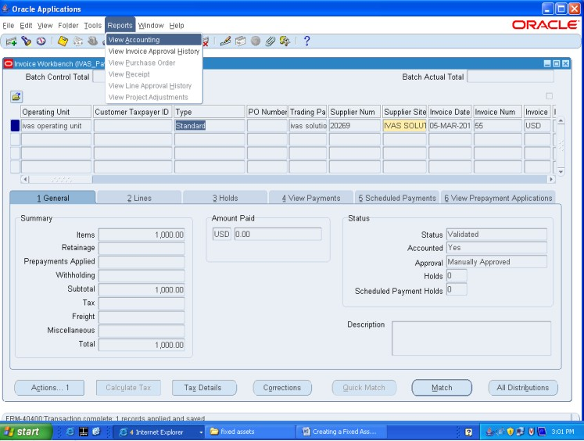
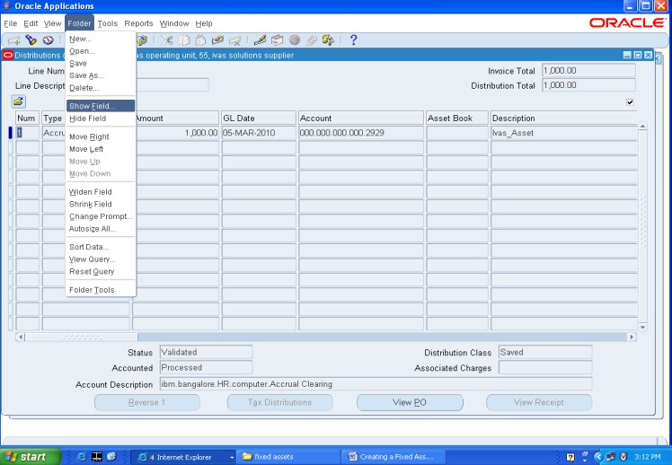
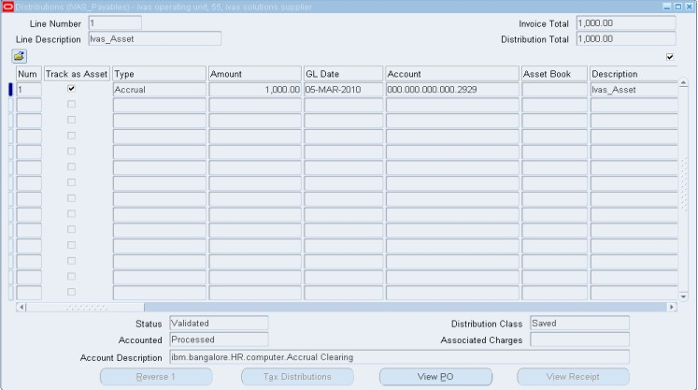
6- Accounted Changes To Yes.
9 - Click on All Distributions.
7- Menu -> Reports -> View Accounting.
8 - Menu-> Folder-> Show Field.
10- Select Track as Asset and Click on OK.

Slide 9
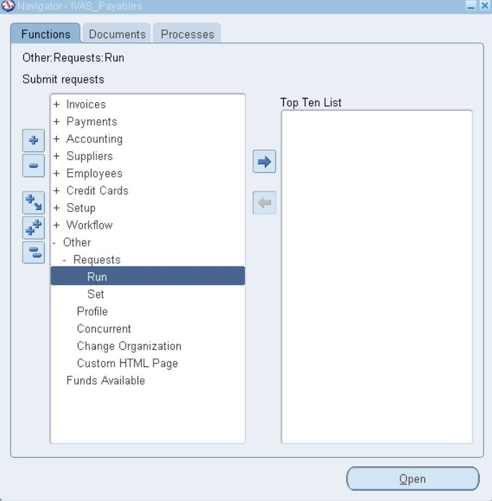
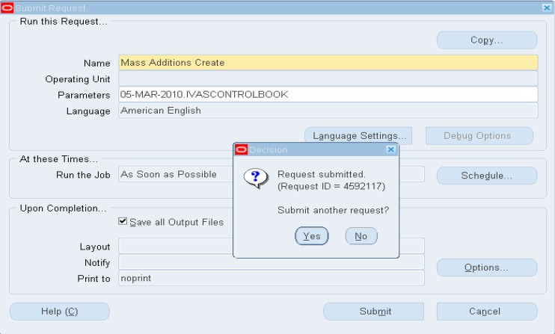
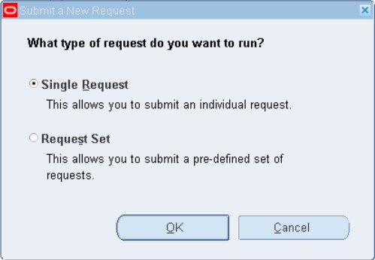
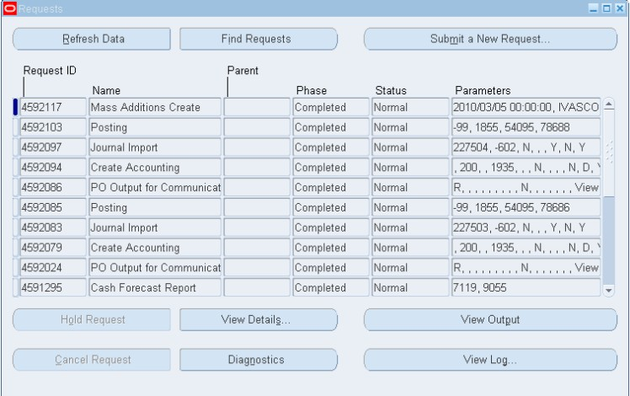
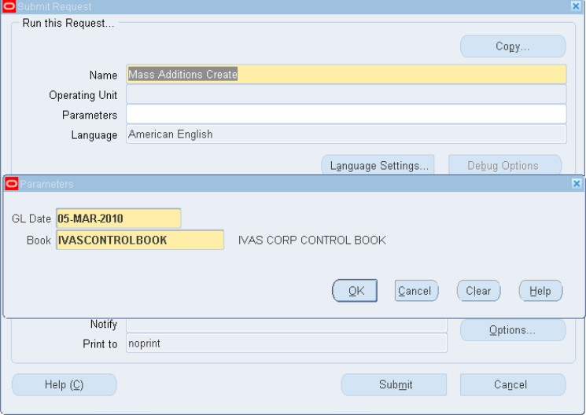
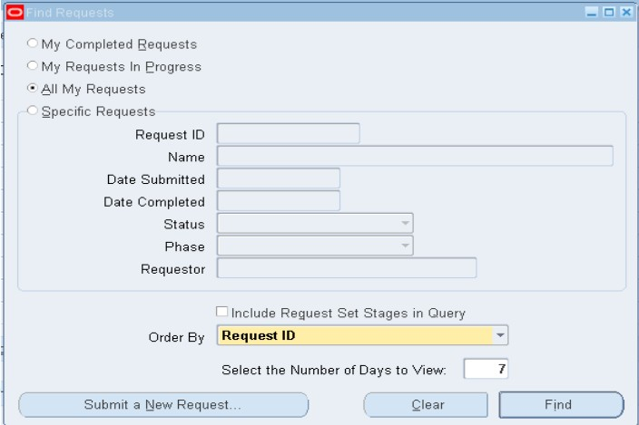
11- Other - > Requests - > Run - > Request Set .
13- Submit the Request then Click on No.
15- Check the phase Status changed to completed.
Click on Find
12- Program Mass Additions Create enter the Parameters and click on OK.
14- Menu -> View -> Requests.

Slide 10
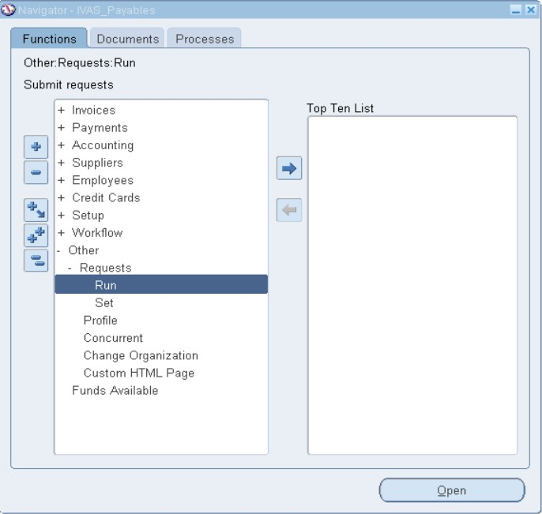
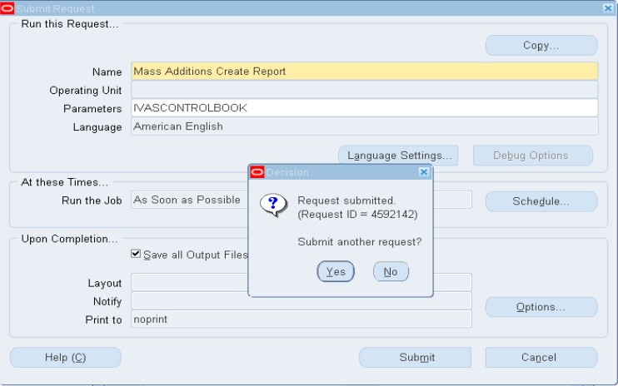
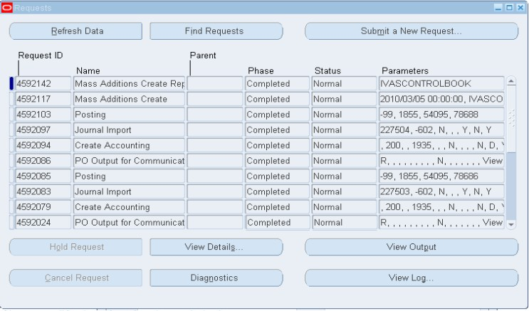
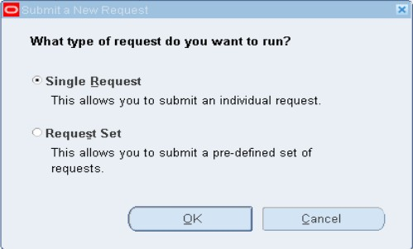
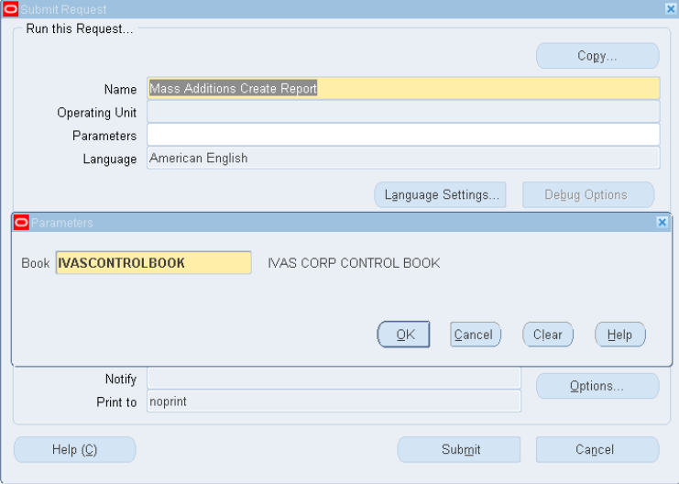

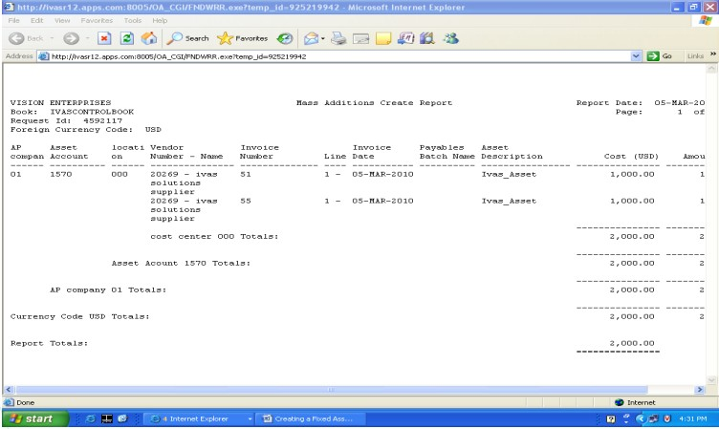
16- Other -> Requests -> Run -> Single Request
19- Click on View Output.
17- Run the ‘Mass Additions Create Report then enter the Asset book as parameters and click on OK.
18- Click on Find.

Slide 11
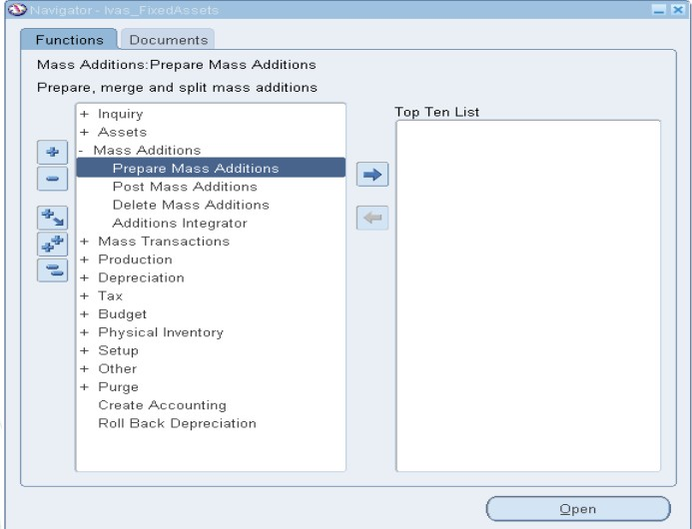
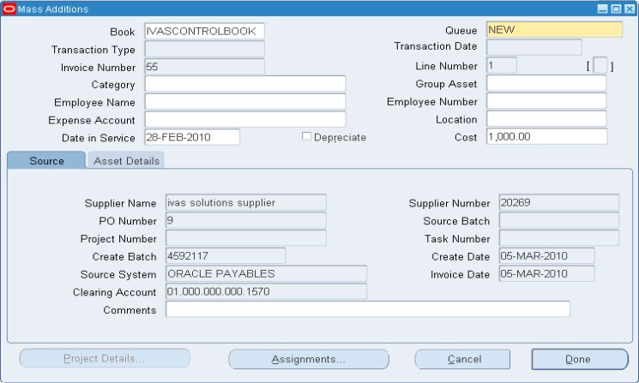
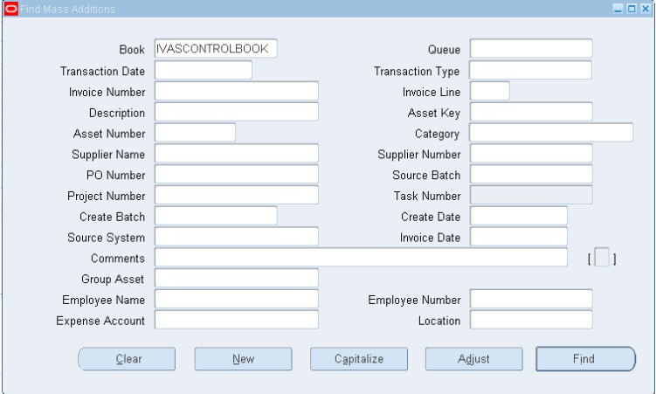
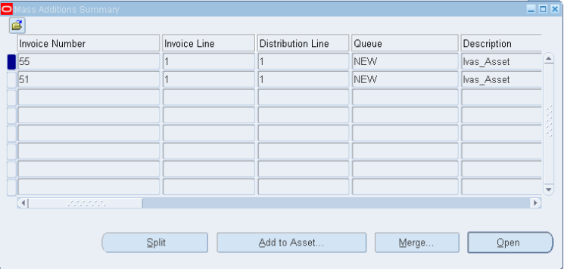
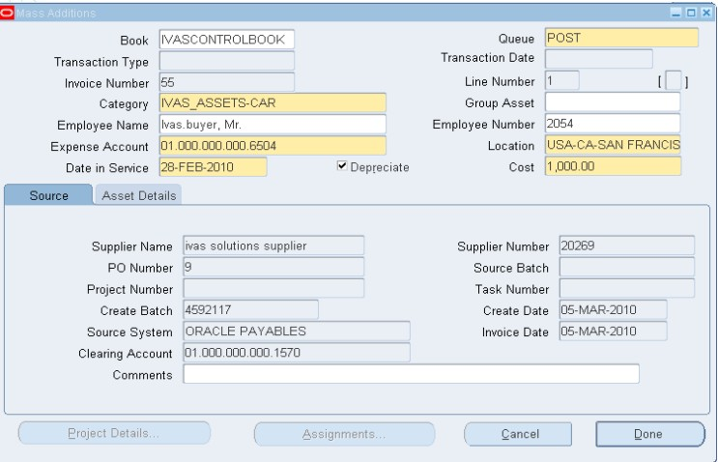
Mass Additions Process Overview:
Create - Enter data in Payables or other systems, then run the mass additions process.
Review - Adjust, merge, or split mass additions.
Post - Post additions to Oracle Assets.
Clean up - Delete and purge unnecessary entries.
*Queues: Mass additions are assigned to queues based on their status, which updates with each transaction.
20- Mass Additions -> Prepare Mass Additions.
23- Change the Status of Queue from New to Post and Enter the Required Data Then click on Done Then review the mass additions through Asset workbench to check before Post the mass additions.
21- Enter the Book name as IVASCONTRO LBOOK then Click on Find.
22- Select the Invoice number then Click on Open.

Slide 12
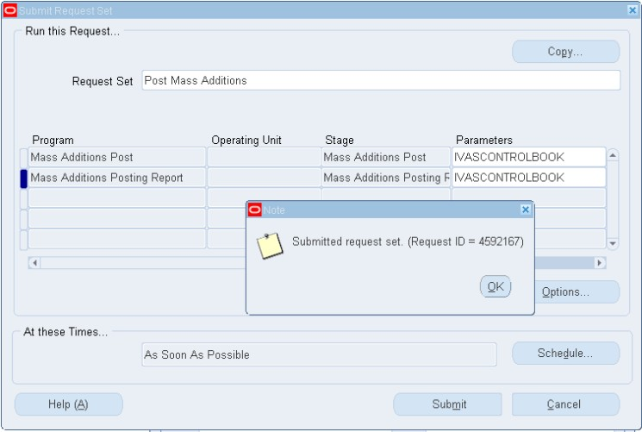
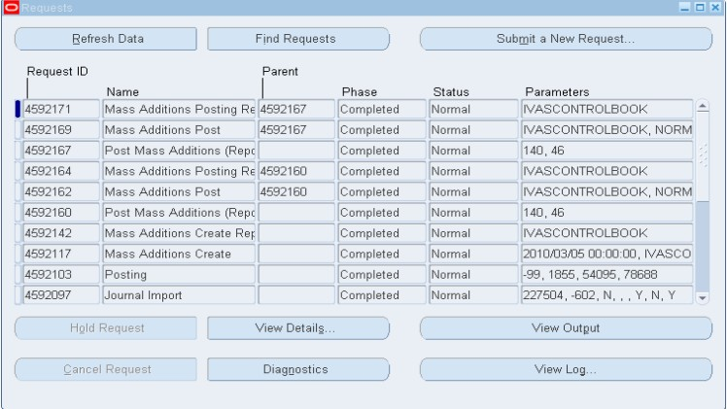
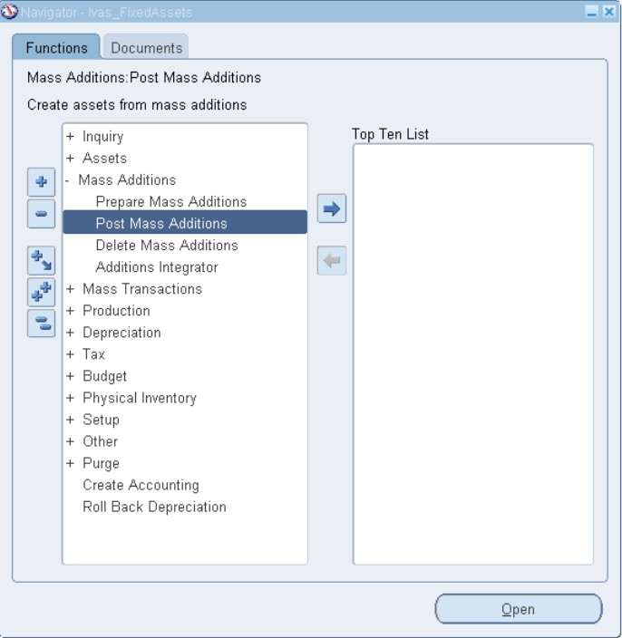
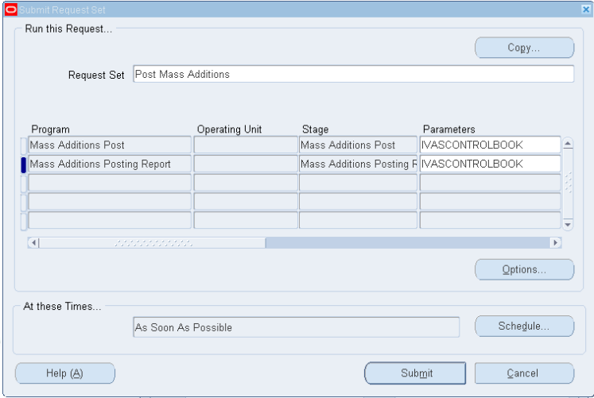
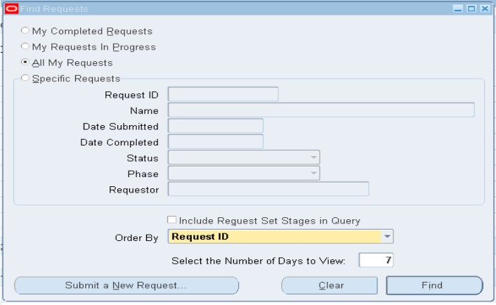
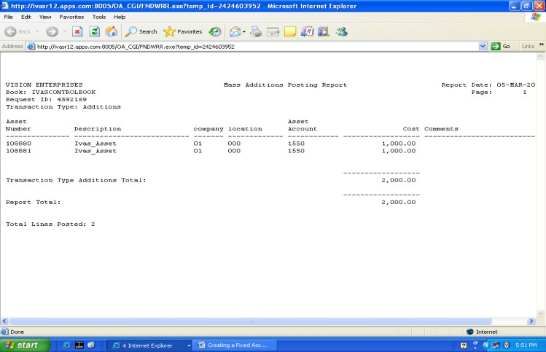
To post mass addition lines to Oracle Assets:
1- Choose Mass Additions > Post Mass Additions from the Navigator.
3- Click on Submit.
.
5- Click on View Output.
*Asset Numbers 108880 and 108881 Assets are added to Asset Workbench.
2- Enter the parameters as IVASCONTROLBOOK.
.
4- Menu -> View -> Requests -> Find .

Slide 13
3- Asset Categories.
Oracle Assets uses the category flex field to group your assets by financial information. You design your category flex field to record the information you want. Then you group your assets by category and provide default information that is usually the same for assets in that category.
Category Structure.
Consider how you want to group your assets. Identify which assets share depreciation methods and conventions. You should also decide how many segments your category structure requires and enter general ledger accounts and default depreciation rules for a category when you add a new category.
Major Category
Major Asset Categories refer to high-value assets that have a significant impact on a company's financial performance and operations. These assets typically include items such as:
Buildings: Real estate owned by the company, such as offices and warehouses.
Heavy Machinery: Equipment used in manufacturing, construction, or industrial processes.
Vehicles: Company-owned cars, trucks, and specialized vehicles used for operations.
Minor Category
Minor Asset Categories are classifications for lower-value assets that have a minimal impact on a company's overall financial performance and operations. These assets typically include items like:
Office Furniture: Desks, chairs, and cabinets.
Small Equipment: Tools, appliances, and other low-cost devices.
Computers and Electronics: Laptops, printers, and similar items.
Create Asset Categories
Use the Asset Categories form to enter the asset category name using the defined segments. Also, enter the default information for the category. Each category must be defined for a book in the Asset Categories form before you can enter assets under it.

Slide 14
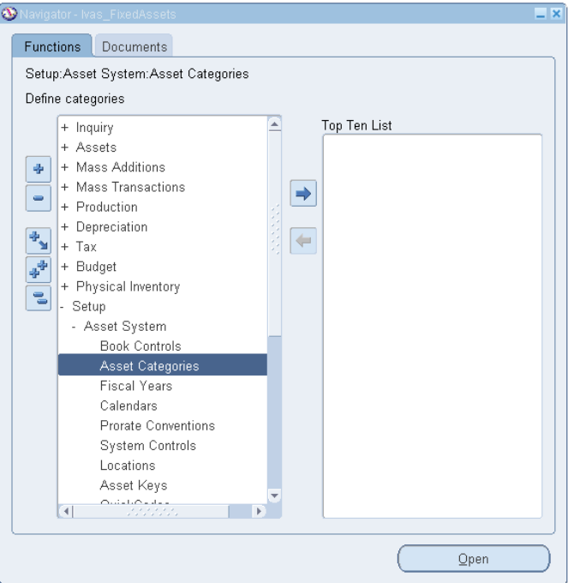
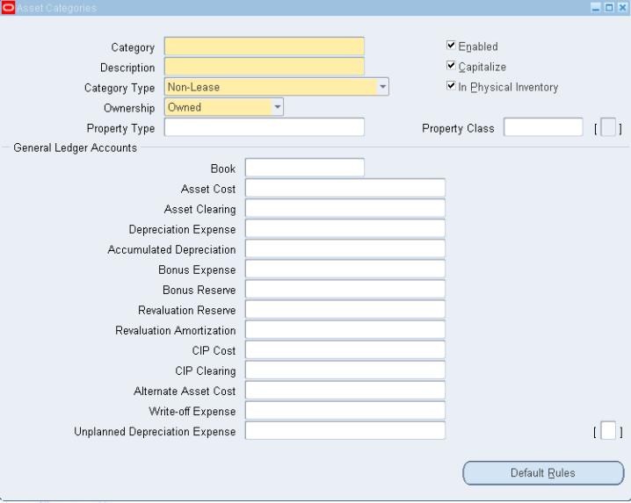
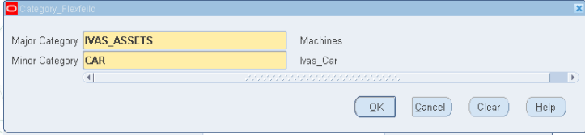
To assign Assets to appropriate categories based on the organization`s asset structure.
Navigation: Setup -> Asset System -> Asset Categories
To set up an asset category:
1. Open the Asset Categories window.
2. Enter a Category name and Description (limit to 20 characters for display purposes).
3. Check Enabled if the category is active.
4. Check Capitalize to charge items to an asset account and depreciate them.
5. Check In Physical Inventory to include assets in inventory comparisons.
6. Select Lease, Leasehold Improvement, or Non-Lease from the Category Type.
7. Choose Owned or Leased for Ownership.
8. Enter the Property Type and Class (e.g., 1245 for personal property, 1250 for real property in the U.S.).

Slide 15
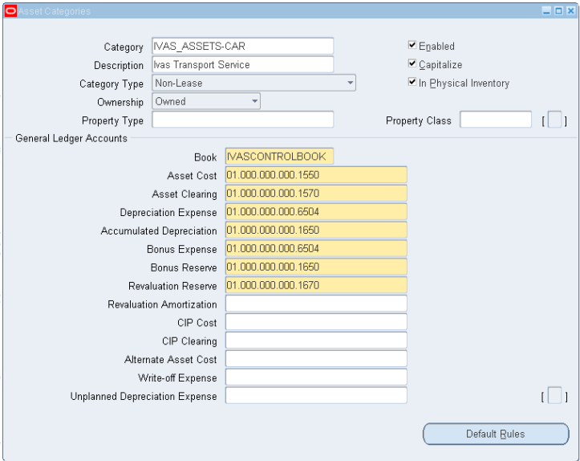
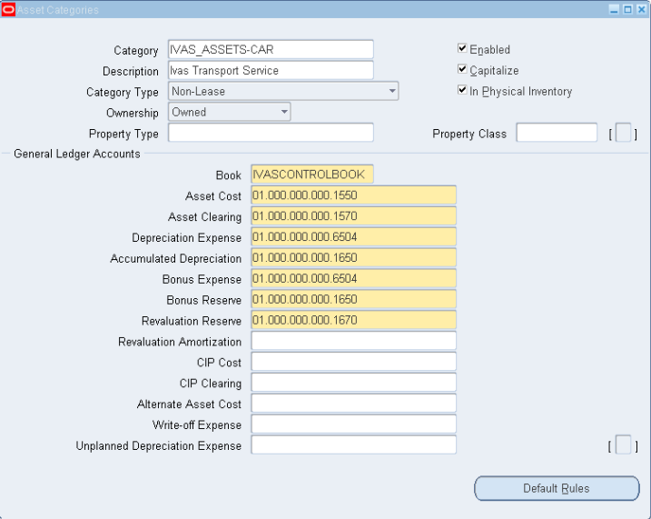
To enter General Ledger accounts for an asset category:
1. Select the Book for the asset category.
2. Enter the Asset Cost account.
3. Enter the Asset Clearing account.
4. Enter the Depreciation Expense account.
5. Enter the Bonus Expense account (optional).
6. Enter the Accumulated Depreciation account.
7. Enter the Bonus Reserve account (optional).
8. Enter the Revaluation Reserve account.
Click on Default Rules

Slide 16
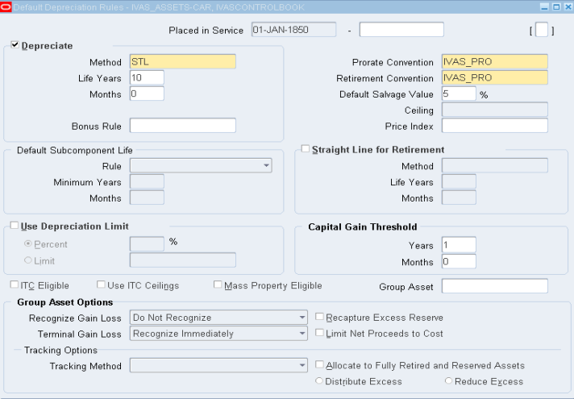
6. Enter the Default Salvage Value percentage if applicable.
7. Optionally, enter a Depreciation Expense or Cost Ceiling for tax books.
8. Enter a Price Index for revaluation reports.
9. Specify a Subcomponent Life Rule (None, Same End Date, or Same Life).
10. If using Same End Date, enter the Minimum Life.
11. Check Straight Line for Retirements for 1250 property in tax books, and set the method and life.
12. Check Use Depreciation Limit if needed and enter a limit.
13. Set the minimum holding time for capital gain reporting.
14. Indicate if assets are eligible for Investment Tax Credit (ITC) and ITC Ceilings.
15. Check Mass Property Eligible if applicable.
16. Assign a Group Asset if needed then Save your work.
Similarly enter the General Ledger Accounts for Tax Book also.
Entering Default Depreciation Rules for a Category
To enter default depreciation rules for a category:
1. Enter the Placed in Service date range for the category.
2. Check Depreciate if assets in this category are normally depreciated.
3. Enter the Depreciation Method and relevant details (life, rates, UOM, etc.).
4. Enter the Bonus Rule if applicable.
5. Set the Prorate Convention and Retirement Convention.

Slide 17



N: - Setup-> Asset System-> Asset Categories
Click on Default Rules
Save and close
Create another Asset Categories
Major as IVAS_ASSET
Minor as Truck
N: - Setup -> Asset System -> Asset Categories

Slide 18



Click on Default Rules
Save and Close
Similarly Major as IVAS_ASSET,
Minor as Truck
Assign to Tax Book
N: - Setup -> Asset System -> Asset Categories

Slide 19



Save and close

Slide 20




4- Asset Inquiry.
It allows users to view asset details, status, history and Analyze the impact of newly added assets on the financial reports.
Assets Financial Inquiry
1- Assets-> Asset Workbench.
2- Enter the Book name and click on Find.
3-Select the Asset you want to inquiry about it.
4-Click on Financial Inquiry.
Check the Cost , Recoverable Cost , Depreciation and Cost History of Asset then Close the form.

Slide 21
Asset Depreciation And Transactions
Keys Elements :-
1- Run Depreciation. 2- Asset Transfers.
3- Asset Adjustments. 4- Asset Inquiry and Reporting.
1- Run Depreciation.
Depreciation Calculation
Run the depreciation program independently for each of your depreciation books. The depreciation program calculates depreciation expense and adjustments, and updates the accumulated depreciation and year-to-date depreciation.
When you run depreciation, the depreciation program submits three separate requests to:
Calculate gains and losses for retired assets and catch up depreciation for retired and reinstated assets
Calculate depreciation expense and adjustments for the period, and close the current period
Run the reserve ledger report

Slide 22





The Depreciation program calculates Depreciation Expense and Adjustments, and updates the Accumulated Depreciation and Year-To-Date Depreciation.
1- Navigate to: Depreciation Run Depreciation .
2- Choose the Book for which you want to run Depreciation then click on Run.
*To the depreciation just check this box
.
Attention
- Once you Close Period, you cannot Reopen it.
- You cannot enter transactions for the book while Depreciation is running.
- You cannot enter transactions for the book while the Periods Closed.
Oracle Assets automatically Closes Period and Opens next Period for the book after calculating Depreciation and Close Period.
3- To view your running request Navigate to: View ➔ Requests ➔ Click Find.

Slide 23


2- Asset Transfers.
You can transfer assets in two ways: first, using the Asset Workbench and make it manually , and second, through Mass Transfers.
Mass Transfers
Use this form to transfer a group of assets between general ledger expense accounts, employees, and locations.
1- Choose Mass Transactions > Transfers from the Navigator window.
2- Choose the corporate depreciation Book for the assets you want to transfer and Enter one or more selection criteria .
* Choose Preview to run the Mass Transfers Preview report. Use this report to preview the expected effects of the Mass Transfer before you perform it. If necessary, update the definition and run the preview report again.

Slide 24



3- View -> Requests -> Find .
4- Click on View Output .

Slide 25





3- Asset Adjustments.
2- Select The book you want Then find the required asset by asset number then click on find.
To make asset adjustments:-
1. Select the Asset: Find the asset you want to adjust.
2. Choose Adjustment Type: Decide on the type of adjustment (e.g., cost or useful life any other details could be adjusted).
3. Enter Details.
4. Review and Save: Check the information for accuracy and save the changes.
1- Assets -> Asset Workbench .
3- Click on Assignments
4- change the asset`s location Then click on Done.
Asset`s location has been modified.

Slide 26




4- Asset Inquiry and Reporting.
Use the inquiry tool to review depreciation details for specific assets.
2- Select The Book then click on Find .
1- Inquiry -> Financial Information.
3- Select the asset you want to inquire about, then click on "Books.".

Slide 27





Run reports on Depreciation , Transfers and Adjustments .
- Run reports on Depreciation (Form 4562 – Depreciation and Amortization Report) .
1- Other -> Requests -> Run ->Single Request ->ok.
2- Select The Report name then fill the parameters then click on ok.
3- From View -> Requests ->Find .
4- Select the repost -> View outputs .

Slide 28



- Run reports on Transfers (Asset Transfers Report) .
1- Other -> Requests -> Run ->Single Request ->ok.
2- Select The Report name then fill the parameters then click on ok.
3- From View -> Requests ->Find .
4- Select the repost -> View outputs .

Slide 29



- Run reports on Adjustments (Financial Adjustments Report) .
1- Other -> Requests -> Run ->Single Request ->ok.
2- Select The Report name then fill the parameters then click on ok.
3- From View -> Requests ->Find .
4- Select the repost -> View outputs .

Slide 30
1-Assets Retirements.
3- Asset Retirement And Period Close.
Keys Elements :-
1- Assets Retirements. 2- Mass Retirement Process.
3- Period-End Closing. 4- Generate Final Asset Reports.
Key :-
Asset Retirements:
- Retire Assets Manually.
- Post Retirement Entries And Review The Impact On The Financials.
Mass Retirement Process:
- Process For Mass Retirement.
- Run The Mass Retirement Process And Post Results.

Slide 31


1- Asset Retirements:- There are two main types of asset retirement: - Fully Retirement: Confirms that the asset is no longer in use and its entire value is retired. - Partially Retirement: Involves determining which specific part is being retired and assessing its value. *To Fully retire an asset:
2- Find the asset you want to retire by using asset number or tag number.
3 - Then press Find .
1-Choose Assets>Asset Workbench from the Navigator window.
2
1
3

Slide 32



4- Select the asset .
5- Press Retirements button.
6- Select the Depreciation Book ,enter the date of the retirement, the proceeds of the sale .
7- Enter all the units or the entire cost.
8- Then Click on Done.
9- Then Click on Ok.
6
4
* Enter any removal costs if applicable .
5
7
9
8
* if you have any additional information it could be included in the asset details such as invoice number , Retirement Type ,….)

Slide 33

*To partially retire the asset
Apply all the pervious steps related to the fully retirements except for the sales amount.
10- Enter the assessed value and any additional information you wish to include, then click "Done.“
Oracle Assets assigns each retirement transaction a unique Reference Number that you can use to track the retirement.
10

Slide 34




11- After the Asset Retirement, run Calculate Gains and Losses program .
Optionally calculate gains and losses to change the status of the retirement transaction from PENDING to PROCESSED or run depreciation it will automatically runs Calculate Gains and Losses program .
11

Slide 35

12- Click on Refresh until the phase changed to completed Data .
13- Then Click on View Output.
12
13

Slide 36




*To review the impact on the financials ( Run Depreciation and Create Accounting ).
* Run Depreciation:
14- Open the Run Depreciation window.
15- Then Choose the Book for which you want to run depreciation then Choose Run.
16 – Then Press ok .
* Create Accounting
17- Menu->View->Requests -> Submit a New Request -> single Request-> Select the Request name as Create Accounting – Assets .
17
16
14
15
Enter the required Parameters then Click on ok and Submit until the phase changed to completed Data then the Journal Entry will be ready .
*Choose whether you want Oracle Assets to close the period after successfully depreciating all assets, once you close it you can`t open it again.
* You can view the output as usual, and the journal will be automatically transferred to the G.L.

Slide 37


2- Mass Retirement Process:-
Mass Retirements can be Used to retire a group of assets at one time .
To retire a Group of assets:
1- Assets > Navigate to Mass Retirements window.
2- Then fill the Assets selection criteria such as :
-The Book from which you want to retire the group of assets.
-The date for the mass retirement.
-The total Proceeds of Sale and the total Cost of Removal for the mass retirement if applicable
2
1

Slide 38


3- You enter selection criteria in the Mass Retirements window to choose the group of assets you want to retire. Enter one or more of the following selection criteria for your mass retirement .
General Ledger Depreciation Expense Account range
Location
Employee Name and Number
Asset Category
Asset Key
Cost Range
Asset Number range
Dates in Service range
4- Then click on Create button then Click on OK and OK .
3
4

Slide 39


5- To Review the View Output and report after the request completes.
Menu->View->Requests -> Find then select the required Requests then Click on View Output
5

Slide 40



6- Post mass retirements. Mass Retirements > Retirements > Post then select a book and press ok then submit
6
* Oracle Assets automatically runs the Mass Retirements Report .

Slide 41





After the Mass Retirements , run the Calculate Gains and Losses program Or Run Depreciation then Creating accounting .

Slide 42
3- Period-End Closing.
What is Period-End Closing?
-Period-End Closing finalizes asset activities for the month, ensuring new additions, retirements, and adjustments are recorded.
Steps for Period-End Closing:-
1- Run Depreciation.
2- Create Accounting.
3- Ensure Complete All Transactions.
Common Issues and Solutions:-
1. Unposted Depreciation: Check if depreciation is fully posted.
2. Pending Transactions: Look for unfinished transactions.
3. Reconciliation: Ensure the Fixed Assets ledger matches the General Ledger.

Slide 43

1- Running Depreciation.
1- Navigate ->Depreciation -> Run Depreciation .
2- Choose the Book for which you want to run Depreciation then check on Close Period Then Run Then ok .
3- Check the phase Status changed to completed.

Slide 44


2- Create Accounting.
2- Chose the book and fill the parameters then ok .
1- Navigate ->Create Accounting.
* Check the phase Status changed to completed.
- Final Asset Reports
What are Final Asset Reports?
- Reports showing asset details, including depreciation and gains/losses.
Key Reports
1. Asset Register Report: Full list of assets.
2. Depreciation Report: Shows recorded depreciation.
3. Gain/Loss Report: Financial results of retired assets.

Slide 45


-Reconciliation:-
Ensure all information in Fixed Assets matches the General Ledger to avoid errors in financial reports.
Ensure that the asset clearing account balances to zero.
Conclusion
Completing Period-End Closing and generating Final Asset Reports ensures financial accuracy and a clear picture of asset performance.

Slide 46
Thank you for reviewing this presentation!

